Slide 1

A Multimedia based Movie Style Model
Presentation by: Dr. Mukesh Saini
Authors: Priyankar Choudhary, Neeraj Goel and Mukesh Saini
Indian Institute of Technology, Ropar, India
IEEE International Conference on Multimedia and Expo-2019
Shanghai China

Slide 2
Outline
Motivation
Target Applications
Key Features of the proposed Model
Problem Statement
Proposed Approach
Experiment & Analysis
Model Validation
Conclusion
References

Slide 3
Motivation
Genres are coarse measure of movie style.
Genres completely ignore the compositional aspects of a movie, thus less informative.
Our aim is to define a more informative and descriptive attribute to define the style of a movie.
The newly proposed attribute can be utilized in a number of applications.
Video Recommendations
Video Authoring
Video Summarization
Video Cataloging

Slide 4
Key Features of proposed Style Model
Model is hybrid as it utilizes visual, auditory and textual features.
Model is developed for full length of movie.
No manual efforts are required in the process of tagging the style.
The model does not require the user generated meta-data.

Slide 5
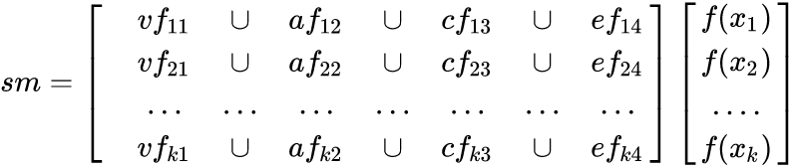
Problem Statement
Input:
n-dimensional feature vector with respect to each movie.
Let vf, af,cf and ef be the visual, auditory, color and emotional features.
sm be the style model. f(.) be the corresponding class label (i.e. director name).
Output : Style model of movies.

Slide 6
Proposed Approach:Feature selection for Style Model
To define the style of a movie:
Need to define the list of features.
Need to validate the utility of features.
Features must be hybrid of visual, auditory and textual information of a movie.
Based on above requirements, we propose an architecture of style attributes.
We also map these real world attributes to mathematical form.
Notes:
In order to develop an alternative to genres, we need to list some potential attributes, which will be utilized as input in our style model
Then we have to prove the utility of those attributes.
Our proposed attributes are not only visuals but auditory and textual also.

Slide 7
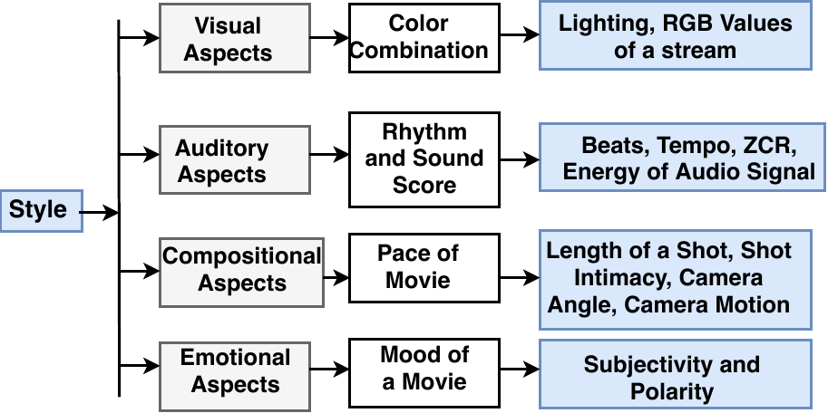
Proposed Approach: Architecture of Style Model
Figure 1. Proposed Architecture of Style Model

Slide 8
Proposed Approach: Framework for Computing Style
The attributes of movies are extracted from audio, video and text.
Shots are extracted from videos to compute visual and compositional attributes.
Visual: Color components of a movie
Compositional: Pace of a movie
Audio helps to determine rhythm and sound-score:
Rhythm: Tempo and Beats
Sound-score: Energy and Zero Crossing Rate (ZCR)
Movie subtitles help to determine the mood of a movie.
Mood: Subjectivity and Polarity
Notes:
Polarity, also known as orientation is he emotion expressed in the sentence. It can be positive, negative or neutral.
Subjectivity is when text is an explanatory article which must be analysed in context. Subjective expressions are opinions that describe people's feelings towards a specific subject or topic.

Slide 9
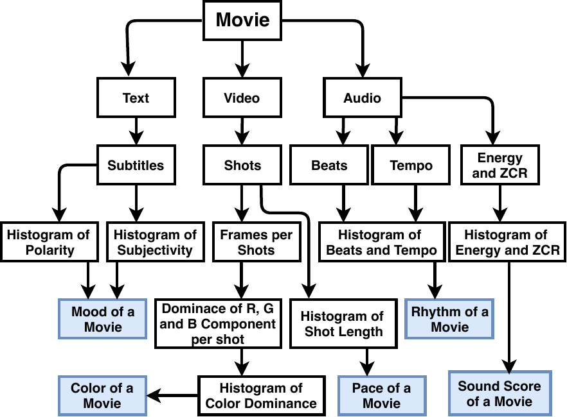
Proposed Approach:Framework for Computing Style
Figure 2. Proposed Framework for Computing Style Model

Slide 10
Implementation Details
We used standard libraries to compute the features from a movie.
Pace of Movie: PySceneDetect (to detect shots)[2]
Rhythm and Sound-score: Librosa [3]
Mood: Textblob [4]
Color of a movie: Average of R, B and G component with respect to each shot
Libraries are supported in python.

Slide 11
Experiments
It is very hard to assess the style of a movie as there is lack of ground truth.
We take a case study for four Hollywood directors who are known to create movies in a specific style.
Christopher Nolan, James Cameron, Steven Spielberg, Michel Bay
Used 20 movies in experiment, 5 movies with respect to each director
Movies collected concerning each director irrespective of the box-office performance.
This case study is taken to validate the style attributes and use of the overall model as movie style.

Slide 12
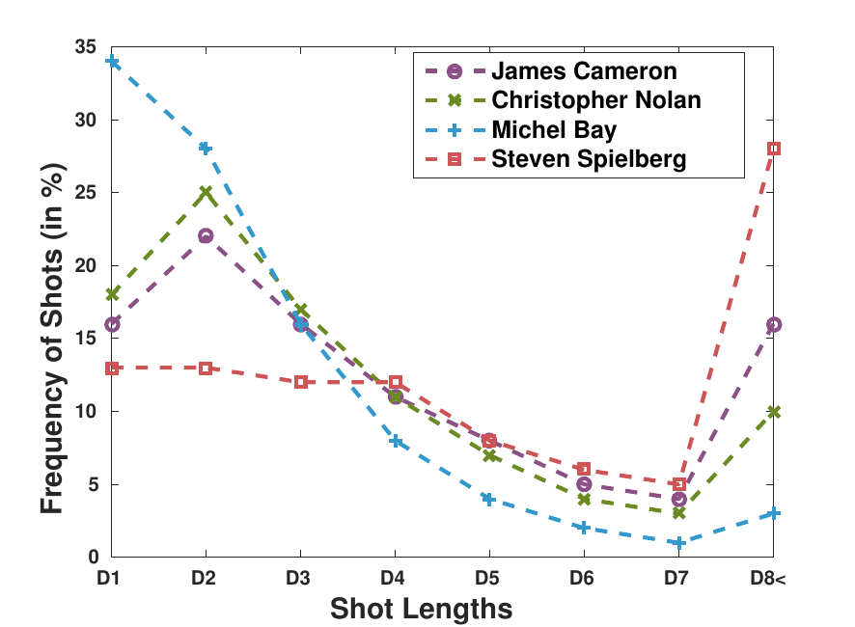
Analysis of Compositional Attributes (Pace)
Figure 3. Histogram of shot length distribution
Notes:
we make a histogram of shot length where each bin represent the duration of 1 second and bin frequency represents the percentage of shots of that duration.
Di represents the shots of duration (i−1,i] seconds.
The movies directed by Michel Bay has shots of shorter duration than Steven Spielberg so the pace of movies directed by Michel bay is faster than Steven Spielberg.
It is a well-known fact that the duration of shot-length in drama films is longer than action film.

Slide 13
Analysis of Compositional Attributes (Pace)
Table 1: Estimated average color intensity with respect to each director
 | Pace of Movies
Director Name | Dominance of Red Color | Dominance of Green Color
James Cameron | 62.12 | 59.36
Christopher Nolan | 37.57 | 35.26
Michel Bay | 59.01 | 66.17
Steven Spielberg | 58.01 | 56.44
Notes:
We see that James Cameron has a higher dominance of red and blue color than any other director.
The dominance of green color is the highest in the movies of Michel Bay whereas Christopher Nolan has the lowest dominance of green color.

Slide 14
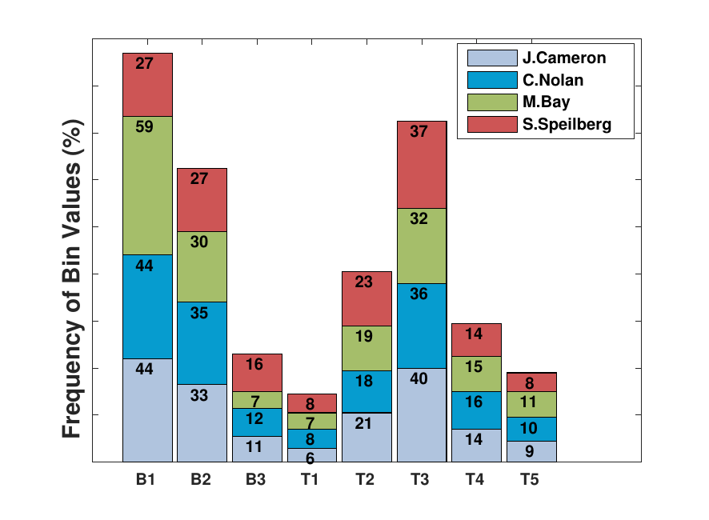
Analysis of Auditory Attributes (Rhythm)
Figure 4. Histogram of beat and tempo values with respect to each director
Notes:
Only dominant bins has been shown, Other bins had very small values, so we removed them
T1 indicates percentage portion of tempo values below 90 beats per minutes with respect to each director. [T2; T3; T4; T5] are 4 equi-width bins of histogram of tempo values in range of [90-130] beats per minutes. [B1,B2,B3] are three equi-width bins histogram out of beat values in range of [1-150].
Highest tempo rate is achieved by Michel Bay (MB) followed by Christopher Nolan (CN). James Cameron (JC) and Steven Spielberg (SS) have lower tempo values respectively.
The average values of tempo are 129 (MB), 128(CN), 127.6(JC) and 126.6(SS) beats per minutes, respectively.
On the analysis of bin histogram, we find that the number of lower beat components are higher. We find distorted bell shape pattern in the distribution of tempo.

Slide 15
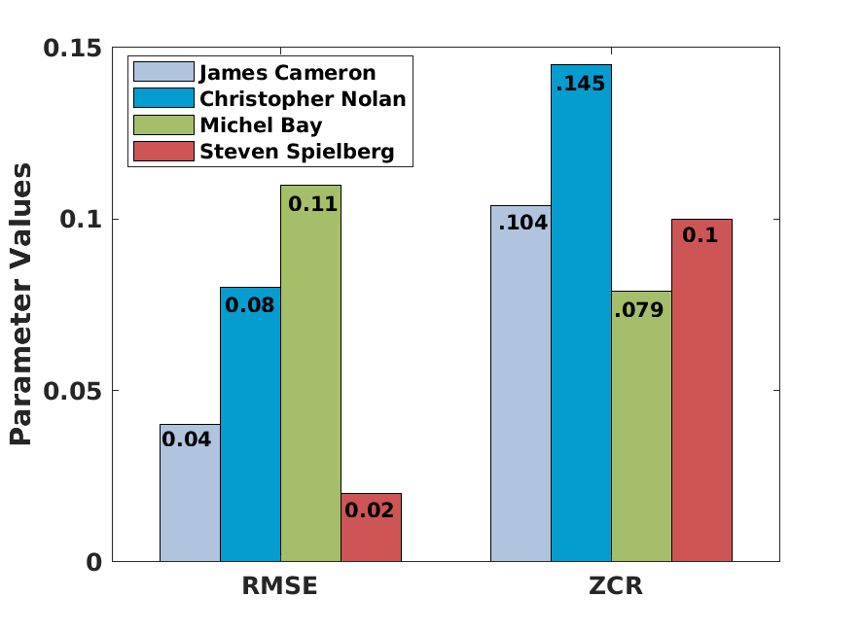
Analysis of Auditory Attributes (Sound-Score)
Figure 5. Average value of RMSE and ZCR with respect to each director
Notes:
We also find that the movies directed by Michel Bay have the highest RMS energy, whereas the movies directed by Steven Spielberg has the lowest RMS energy.
We also observe that Christopher Nolan and Michel Bay have the highest and the lowest ZCR respectively

Slide 16
Analysis of Visual Attributes (Color)
Table 1: Estimated average color intensity with respect to each director
 | Color of Movies
Director Name | Dominance of Red Color | Dominance of Green Color | Dominance of Blue Color
James Cameron | 62.12 | 59.36 | 63.62
Christopher Nolan | 37.57 | 35.26 | 33.34
Michel Bay | 59.01 | 66.17 | 62.63
Steven Spielberg | 58.01 | 56.44 | 58.84
Notes:
We see that James Cameron has a higher dominance of red and blue color than any other director.
The dominance of green color is the highest in the movies of Michel Bay whereas Christopher Nolan has the lowest dominance of green color.

Slide 17
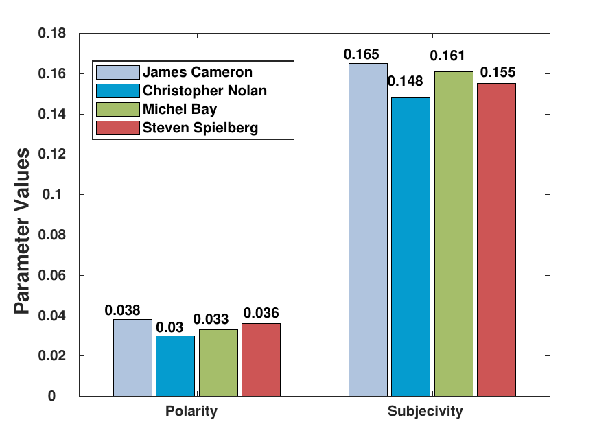
Analysis of Emotional Attributes (Mood)
Figure 6. Average value of Polarity and Subjectivity with respect to each director
Notes:
We also find that the movies directed by Michel Bay have the highest RMS energy, whereas the movies directed by Steven Spielberg has the lowest RMS energy.
We also observe that Christopher Nolan and Michel Bay have the highest and the lowest ZCR respectively

Slide 18
Model Validation
To validate our movie-style model, we predicted the director associated with each movie with the help of the features discussed above.
Since the directors are known to have a particular movie making style, a good accuracy of classifier reflects the effectiveness of our style model.
To assess the importance of an individual attribute, we removed one of the attributes and calculated the accuracy.
We used leave-one-out cross-validation.

Slide 19
Model Validation (Contd.)
Different frameworks to validate the movie style models are as follows:
FMH: Framework based on the work of Saini et al.(Base approach for comparison)
FMA: Framework which consists of all the features (Proposed)
FMS: Framework without Sound-Score Features
FMR: Framework without Rhythmic Features
FMM: Framework without Mood Features
FMC: Framework without Color Features
FMP: Framework without Pace Features
We evaluated our model by using Random Forest, Decision Tree and Extra Trees, AdaBoost and Stochastic Gradient Boosting.
Notes:
We are trying to find out which feature contributes more in accuracy,
so we are removing features one by one and analyze how much decrease in accuracy take place.

Slide 20
Model Validation [Criteria: Accuracy(%)]
Table 2: Accuracy (in %) of the proposed framework for director label prediction task
Director Name | FMH [1] | FMA | FMS | FMR | FMM | FMC | FMP
AdaBoost | 27.5 | 58.5 | 59.5 | 25.5 | 57.0 | 36.0 | 58.5
Random Forest | 48.5 | 80.0 | 81.0 | 67.5 | 82.0 | 67.5 | 78.5
Extra Trees | 47.0 | 83.0 | 76.5 | 70.5 | 78.5 | 70.0 | 77.0
Decision Tree | 40.0 | 84.0 | 82.5 | 65.0 | 84.0 | 66.0 | 84.5
Gradient Boosting | 38.0 | 76.5 | 78.5 | 66.0 | 76.5 | 40.0 | 77.0
Model Accuracy (%) | 40.2 | 76.4 | 75.5 | 58.9 | 76.5 | 55.9 | 75.1
Notes:
We see that James Cameron has a higher dominance of red and blue color than any other director.
The dominance of green color is the highest in the movies of Michel Bay whereas Christopher Nolan has the lowest dominance of green color.

Slide 21
Conclusions and Future Work
We presented a framework to model the style of a movie.
We also validated our model with a case study of four directors.
The attributes of the model capture various aspects of the movie style.
We achieved an accuracy of 76.4% over various combinations of attributes.
Rhythm and colors are most important features as removal of these features decrease the accuracy.
We intend to incorporate more complex features, namely, motion intensity, camera motion develop a method for movie automatic movie style transfer.

Slide 22
References
Saini MK, Gadde R, Yan S, Ooi WT. MoViMash: online mobile video mashup. InProceedings of the 20th ACM international conference on Multimedia 2012 Oct 29 (pp. 139-148). ACM.
Breakthrough, “Breakthrough/pyscenedetect: A python based library for video scene cut detection and analysis tool,” Jul 2018.
Librosa, A python based library for music and audio analysis,” https://librosa.github.io/librosa/
Textblob: A python based library for simplified text processing,” https://textblob.readthedocs.io/en/dev/

